Slide 1

USING PADDING AND STRIDES IN CNN
By: Suprita ganesh, Pratik kadi,
shreya ganesh

Slide 2


How Does CNN Work?
KERNAL
FILTER
IMAGE

Slide 3
INTRODUCTION
Kernel: A kernel is an integral component of the layered architecture. Generally, it refers to an operator applied to the entirety of the image such that it transforms the information encoded in the pixels
A single convolutional layer of a CNN consists of multiple kernels or filters

Slide 4
PADDING
Padding refers to the process of symmetrically adding zeroes to the input matrix. It's a commonly used modification that allows the size of the input to be adjusted to our requirement.
It is mostly used in designing the CNN layers when the dimensions of the input volume need to be preserved in the output volume.
Padding is usually applied when the filter cannot perfectly fit the image

Slide 5
STRIDES
The filter convolves around the input volume by shifting one unit at a time. The amount by which the filter shifts is called the Stride
Stride is normally set in a way so that the output volume is an integer and not a fraction

Slide 6

ARBITRARY PADDING
NO STRIDES

Slide 7
No PADDING,
Contains STRIDES

Slide 8
Contains PADDING,
Contains STRIDES

Slide 9
Contains no PADDING,
Contains no STRIDES

Slide 10
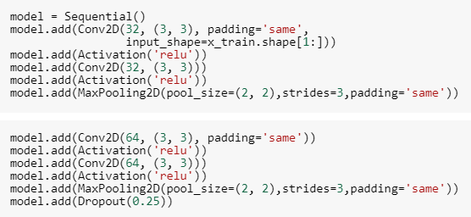
CODE USING PADDING AND STRIDES IN CNN SO FAR

Slide 11
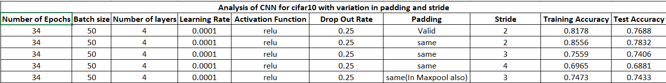
Results

Slide 12
THANK YOU

